Slide 1

Applied Physics
Lec-02
DC Series Circuit
Instructor: Engr. Asif Ali
BE(CS) QUEST Nawab Shah
MS(CS) Sukkur IBA
Engr. Asif Ali

Slide 2
Agenda
DC circuit
Series Circuit
Parallel Circuit
Engr. Asif Ali

Slide 3
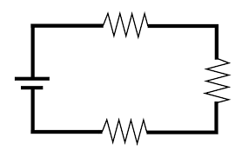
DC Circuit
  When DC voltage source is connected to the load and the current gets close path to flow the structure is called DC circuit.
Engr. Asif Ali

Slide 4
Series Circuit
  A circuit is the fundamental element in any electrical or electronic system. There are two ways to connect electrical components (such as resistors, capacitors, and inductors) in an electric circuit: series or parallel.
  The differences in these two methods affect the way current flows and the potential differences (or voltage) across components.
  In a series circuit, all the components are connected back to back and only one path is available for current to flow.
Engr. Asif Ali

Slide 5
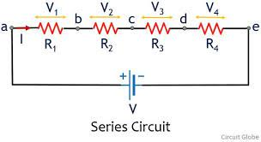
Characteristics of Series Circuit:
  Current: The amount of current is the same through any component in a series circuit.
  Resistance: The total resistance of any series circuit is equal to the sum of the individual resistances.
  Voltage: The supply voltage in a series circuit is equal to the sum of the individual voltage drops.
Engr. Asif Ali

Slide 6
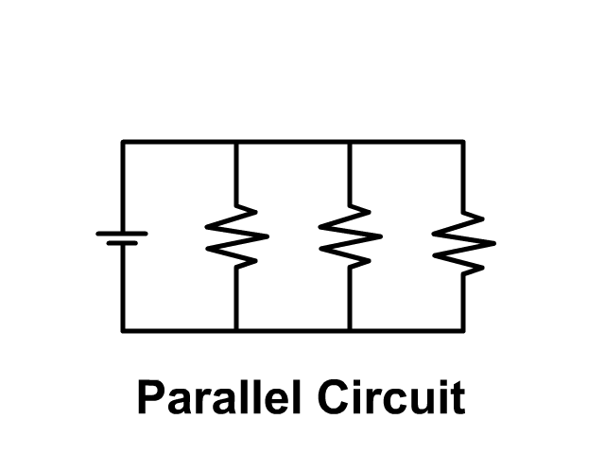
Parallel Circuit
  In parallel circuit all the components are connected across two common points only.
  In a parallel connection, the current in each parallel branch is depends upon the values of the components used in the branch.
  The voltage, however, is the same across components.
  In a parallel connection, the positive ends are connected to the positive ends, and the negative ends are connected to the negative ends.
Engr. Asif Ali

Slide 7
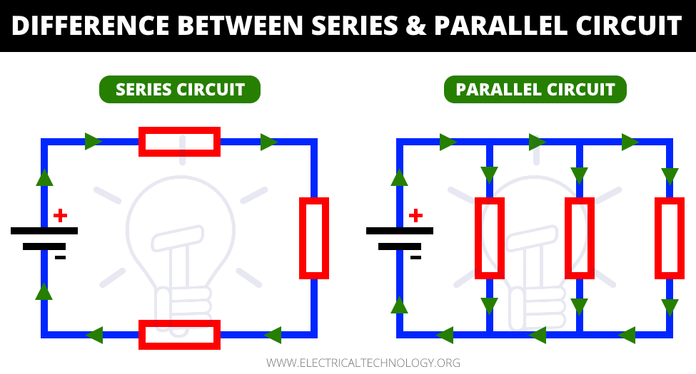
Engr. Asif Ali

Slide 8
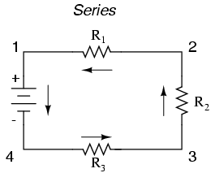
Solve this circuit
Engr. Asif Ali

Slide 9
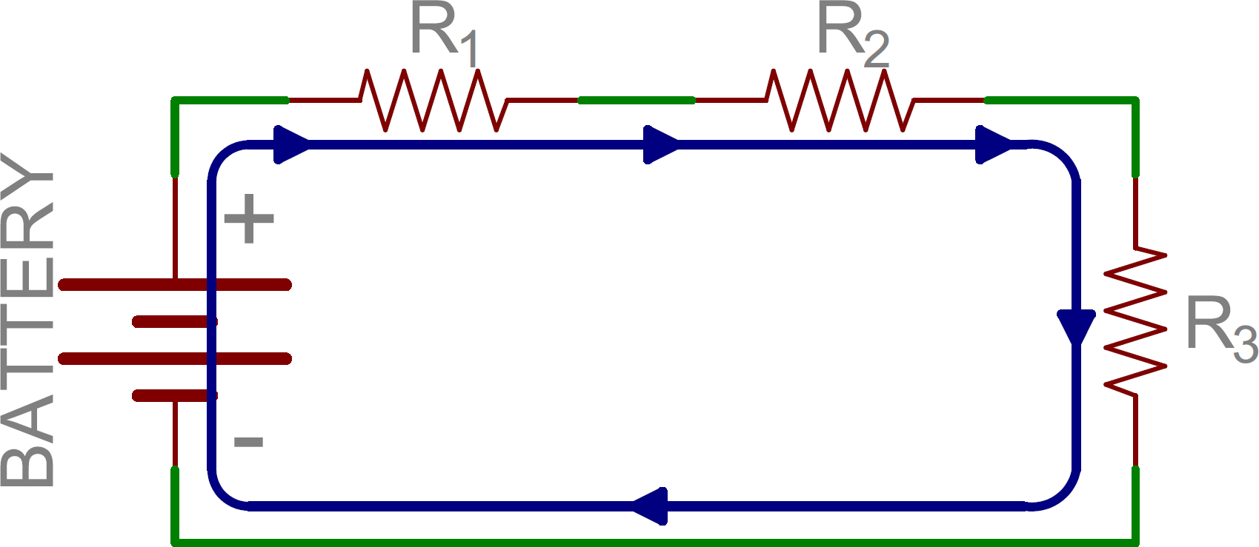
Solve this circuit
Engr. Asif Ali

Slide 10
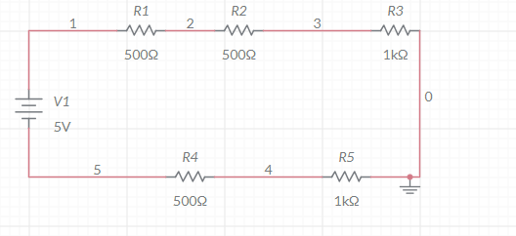
Solve this circuit
Engr. Asif Ali

Slide 11
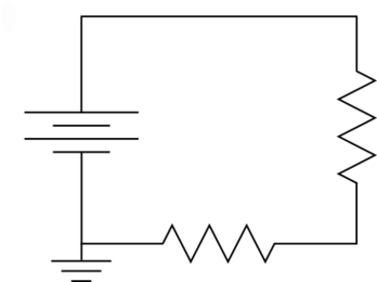
Solve this circuit
Engr. Asif Ali

Slide 12
Table used for Series circuit:
Trial | Applied voltages (V) | Current (A) | Voltage (V1) across R1 | Voltage (V2) across R2 | Calculated Voltages across (R1+R2) V=I (R1+R2)
1
2
3
4
5
6
_
+
+
_
Engr. Asif Ali

Slide 13
Further instructions are written in the lab manual
Engr. Asif Ali

